Slide 1


Google Play App Market Strategy
Data-Driven App Development, UX Optimization, and Monetization Roadmap Powered by Power BI Interactive Visuals & DAX Modeling

Slide 2

Executive Diagnostics
Transforming 10,800+ raw store records into an interactive Power BI intelligence dashboard to inform product development, category selection, and revenue models.

Slide 3

Market Landscape Snapshot
Freemium Dominance in Power BI Insights
10.8K
DAX aggregation across the dataset confirms that 92.6% of Google Play apps are free, capturing over 98.4% of total user downloads.
Upfront payment models create severe conversion friction. Sustainable app monetization depends on freemium tier upsells, recurring subscriptions, and targeted in-app ads.
Analyzed App Profiles

Slide 4
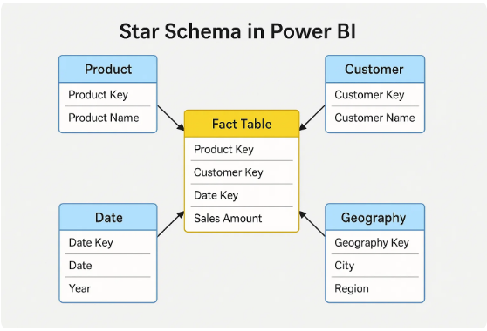
Power BI Data Pipeline & Modeling
Power Query ETL: Cleaned M-code functions converted string payloads (19M, 2.5k) into numeric MBs and standardized install bins (10,000+ to 1B+).
Star Schema Model: Formed a robust data model connecting FactApps to dimension tables (DimCategory, DimPriceTier, and DimRatingBin).
DAX Expressions: Created weighted average ratings, estimated revenue metrics ([Est Revenue] = SUMX(Apps, [Installs] * [Price])), and dynamic slicer measures.

Slide 5


Category Opportunity Grid
1. Saturation Alert: Red Oceans
2. High-Demand: Blue Oceans
Family & Game categories account for ~35% of total store listings (~3,800 apps). High saturation means organic discovery requires heavy User Acquisition (UA) ad spend.
Finance, Health & Fitness, and Productivity show outstanding install-per-app ratios. Users exhibit stronger intent and higher lifetime value (LTV) in utility niches.

Slide 6
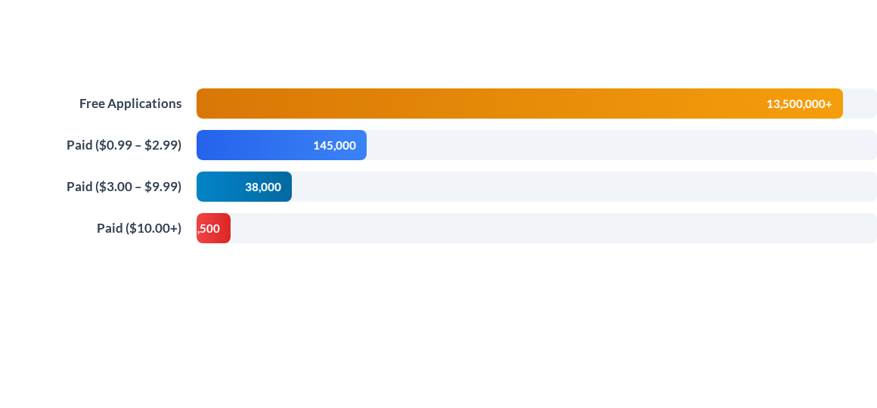
Downloads Across Price Tiers
Power BI Parameterized Chart: Free apps drive 90x more install volume than $0.99 apps. Mobile roadmap must prioritize zero-friction download funnels paired with dynamic in-app upgrades.

Slide 7






Core App Success Drivers
Rating Threshold (4.2+)
Payload Size (< 30MB)
Monthly Update Rhythm
Power BI Sentiment Measures indicate apps rated above 4.2 capture 85%+ of total store downloads. Falling below 4.0 cuts conversion rate by over 50%.
App binary sizes under 30MB achieve 2.4x higher conversion in tier-2/3 global markets where device storage and data caps remain strict.
Apps updated at least monthly show 38% higher 90-day retention, benefiting from active algorithmic boosting in store rankings.

Slide 8
Category Performance Matrix
Category Sector | Avg Size (MB) | Avg Rating | Monetization Model | Power BI Opportunity Score
Game | 64.3 MB | 4.28 / 5.0 | In-App Purchases (IAP) + Ads
Finance | 28.1 MB | 4.13 / 5.0 | Freemium Subscriptions
Health & Fitness | 31.5 MB | 4.25 / 5.0 | Monthly Tiered Plans
Tools & Utilities | 18.2 MB | 4.04 / 5.0 | In-App Ad Network
Family & Casual | 42.7 MB | 4.19 / 5.0 | Hybrid Ad & Micro-IAP

Slide 9

User Review Sentiment
Key Influencers & Social Proof
Using Power BI's AI Key Influencers visual, review volume is identified as the #1 driver of organic store ranking. Crossing 10,000+ positive reviews creates a viral download feedback loop.
Deploying smart in-app review triggers during positive user micro-moments increases 5-star review conversion by 300%.

Slide 10




Power BI Solution Roadmap
Q2 - Interactive DAX Dashboards
Q4 - Service Deployment
Build dynamic slicers, DAX calculated measures, and user sentiment filters.
Publish to Power BI Service with automated scheduled refreshes and RLS security.
Q1 - Power Query Pipeline
Q3 - Power BI AI Integration
Clean raw store CSV logs and construct Star Schema dimensional models.
Deploy Decomposition Trees and Smart Narratives for automated executive reporting.

Slide 11
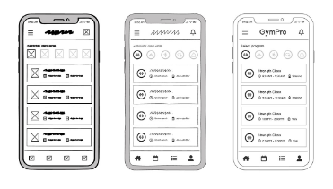
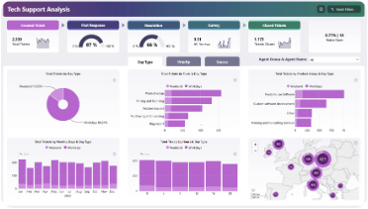
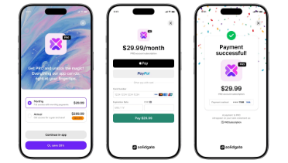
Strategic Action Pillars
Lean UX & Payload Size
Real-Time Power BI Monitoring
Freemium Monetization
Maintain binary size under 30MB and streamline initial onboarding to prevent immediate user drop-off.
Establish live alert thresholds in Power BI Service for rating drops, negative sentiment, and rank changes.
Drive top-of-funnel reach with zero-cost downloads while converting high-LTV users via in-app subscriptions.

